Slide 1
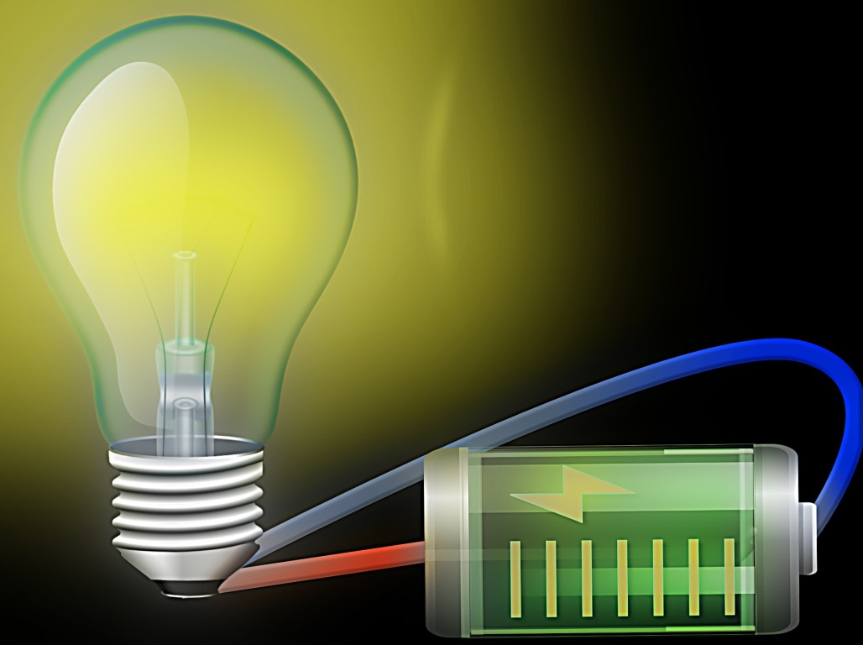
Electric Circuits For Beginners [Search Topics] O-
Welcome!
Get Started Here!
Fun Projects at Home
Terms & Agreements: We are not responsible for anything that you do. All experiments and learning are done at your own risk!
Contact Information:
Jake Westling
jakewestling@gmail.com
Steubenville, OH

